Slide 1
“Online Attendance System” Hajir
Padam Thapa Magar
Pemba Tamang Lama

Slide 2
Introduction
To digitalize attendance management and eliminate traditional paper-based records.
Hajir is an online attendance system design for recording, tracking and managing students attendance in digital format.
Automatically generates insightful attendance reports for daily and weekly analysis.
Authorized personnel can add users and mark attendance effortlessly, while students can view their attendance records in real time.
Enhance efficiency, accuracy, and transparency, eliminating manual errors and administrative hassle.

Slide 3
Problem Statement
Manual attendance systems, where attendance is recorded using paper registers, sign-in sheets, can present a range of challenges.
Error-prone
Time-consuming
Delayed
Vulnerable
Lack of analytics

Slide 4
Objectives
Improve accuracy by minimizing errors such as incorrect entries or missing records.
Save time for teachers and administrators by streamlining attendance tracking.
Provide real-time access to attendance data for quick decision-making.
Securely store attendance records in a database to prevent data loss or tampering.
Generate attendance reports automatically for daily, weekly, or monthly analysis.
Allow authorized users to manage attendance from anywhere within the institution.
Reduce reliance on paper-based records, making the process more eco-friendly and organized.

Slide 5
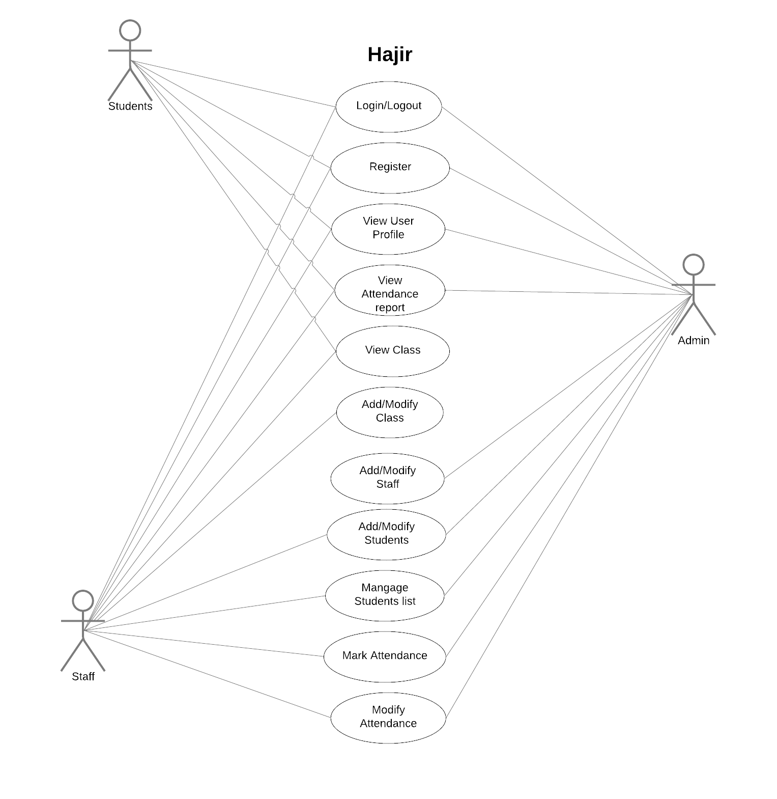
Requirement Analysis
Functional Requirement
Allow administrator to add/edit Students, View Use Profiles and Manage the Reports (i.e manage Student list,modify Class)
Allow the administrator and staff to search for data in the database.

Slide 6
Requirement Analysis
Non-Functional Requirement
Allow administrator to add/edit Students, View Use Profiles and Manage the Reports (i.e manage Student list,modify Class)
Allow the administrator and staff to search for data in the database.
Non-Functional Requirements
Grants access to accounts when users enter the correct username and password
Can be accessed from anywhere, as it is web-based.
Should have a fast login and response time.
Must have sufficient storage capacity to handle large amounts of data

Slide 7
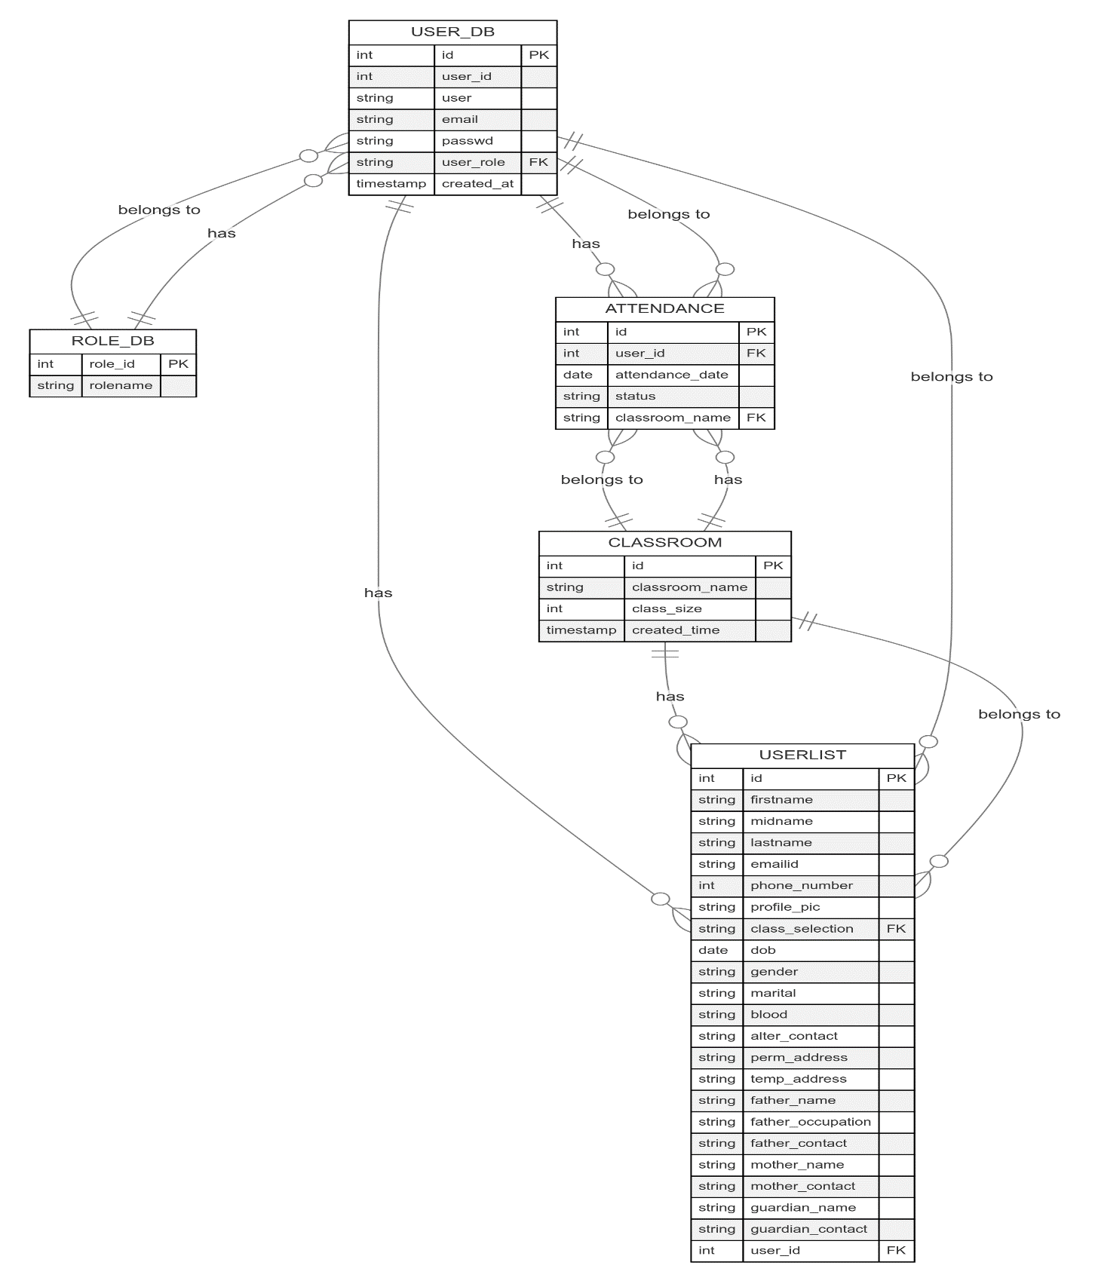
ER-Diagram

Slide 8
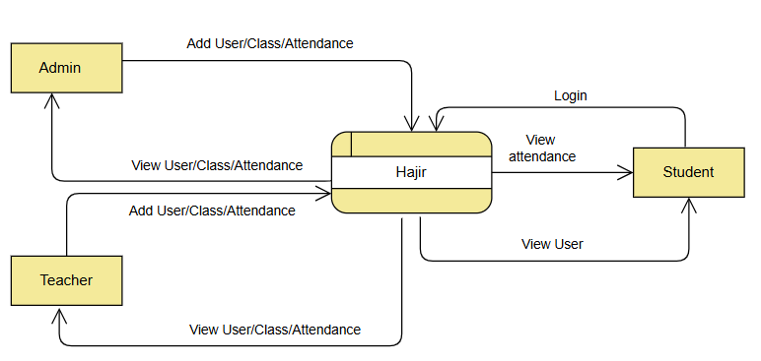
DFD
Figure: Context Level

Slide 9
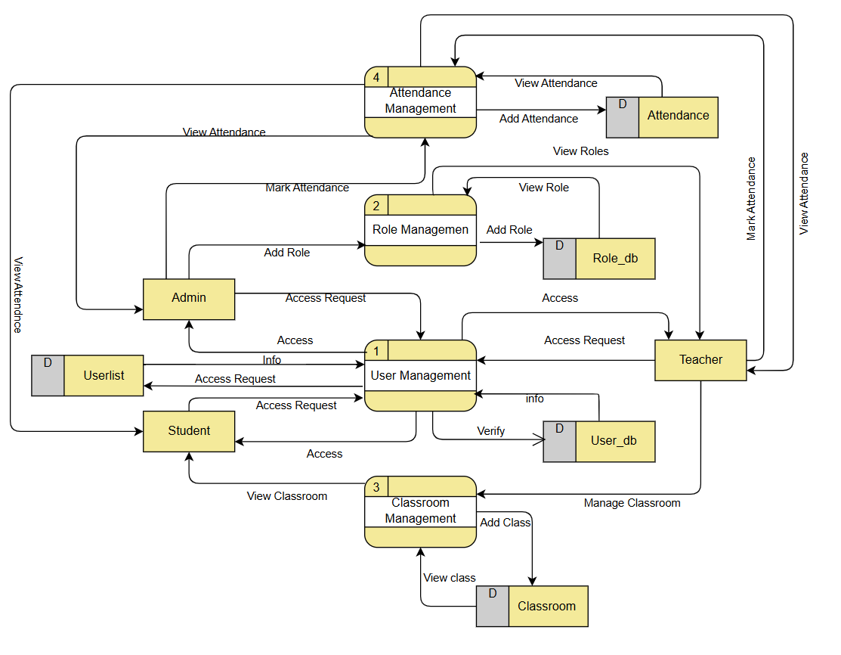
Level 1: DFD
Figure: Level 1 DFD

Slide 10
Implementing Tools
Programming Languages: HTML, CSS, JavaScript (for frontend), PHP (for backend).
Database Platform: MySQL for data storage and management.
Development Tools: VS Code, XAMPP (for local testing).
Version Control: Git.

Slide 11
Conclusions

